Slide 1


FLIPKART LOGISTICS OPTIMIZATION FOR DELIVERY ROUTES
SQL-driven analytics to reduce delays, optimize routes & improve agent efficiency
Dataset: 300 Orders | 20 Routes | 10 Warehouses | 50 Agents | 999 Checkpoints
Tool: MySQL Workbench | Tasks: Data Cleaning · Delay Analysis · Route Optimization · Warehouse · Agent · KPI Reporting
BY- KAMLESH KUMAR THAKUR

Slide 2
PROJECT OVERVIEW
Objective
Challenge
Rising order volumes during festive seasons cause delays, route inefficiencies, and traffic disruptions affecting customer satisfaction.
Build a SQL-driven analytics system to analyze delays, optimize routes, and enhance shipment & agent efficiency using data-driven insights.
Outcome
Approach
Actionable recommendations on route optimization, warehouse bottlenecks, agent training and KPI dashboards for Ekart Logistics.
Leverage 5 relational tables (Orders, Routes, Warehouses, Agents, Tracking) with SQL queries, CTEs, window functions and aggregations.

Slide 3
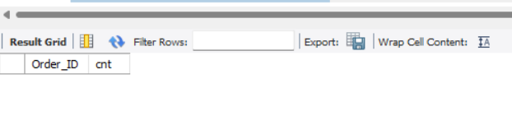
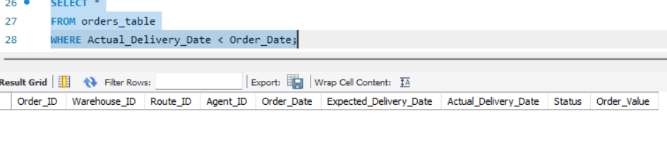
Data Cleaning & Preparation
No duplicate records
Converted data types
Date format already standardized
No null values in Traffic_Delay_Min
No records found where Actual_Delivery_Date is before Order_Date
QUERIES USED
1. SELECT Order_ID, COUNT(*) AS cnt
FROM orders_table
GROUP BY Order_ID
HAVING COUNT(*) > 1;
2. ALTER TABLE orders_table
MODIFY Order_Value DECIMAL(10,2);
3. SELECT * FROM orders_table
WHERE Actual_Delivery_Date < Order_Date;

Slide 4
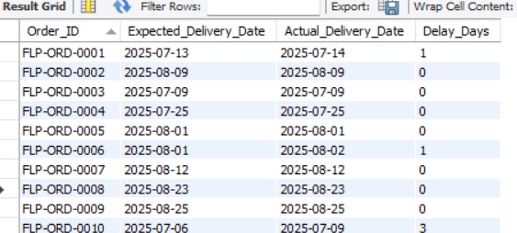
Task 2:Delivery Delay Calculation
Order_ID | Expected_Delivery_Date | Actual_Delivery_Date | Delay_Days
FLP-ORD-0001 | 2025-07-13 | 2025-07-14 | 1
FLP-ORD-0002 | 2025-08-09 | 2025-08-09 | 0
FLP-ORD-0003 | 2025-07-09 | 2025-07-09 | 0
FLP-ORD-0004 | 2025-07-25 | 2025-07-25 | 0
FLP-ORD-0005 | 2025-08-01 | 2025-08-01 | 0
FLP-ORD-0006 | 2025-08-01 | 2025-08-02 | 1
FLP-ORD-0007 | 2025-08-12 | 2025-08-12 | 0
FLP-ORD-0008 | 2025-08-23 | 2025-08-23 | 0
Query-
SELECT Order_ID,
Expected_Delivery_Date,
Actual_Delivery_Date,
DATEDIFF(Actual_Delivery_Date, Expected_Delivery_Date) AS Delay_Days
FROM orders_table;

Slide 5
Top Delayed Orders
Order_ID | Delays_days
FLP-ORD-0166 | 3
FLP-ORD-0118 | 3
FLP-ORD-0025 | 3
FLP-ORD-0079 | 3
FLP-ORD-0092 | 3
FLP-ORD-0077 | 3
FLP-ORD-0129 | 3
FLP-ORD-0165 | 3
FLP-ORD-0010 | 3
FLP-ORD-0121 | 3
Query-
SELECT Order_ID,
DATEDIFF(Actual_Delivery_Date, Expected_Delivery_Date) AS Delay_Days
FROM orders_table
ORDER BY Delay_Days DESC
LIMIT 10;

Slide 6
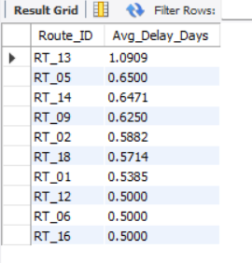
Top Delayed Routes
SELECT Route_ID, AVG(DATEDIFF(Actual_Delivery_Date, Expected_Delivery_Date)) AS Avg_Delay_Days FROM orders_table GROUP BY Route_ID ORDER BY Avg_Delay_Days DESCLIMIT 10;
KEY INSIGHTS:
Route RT_13 was identified as the most delayed route with an average delay of 1.09 days.
Other routes such as RT_05, RT_14, and RT_09 also showed moderate delays. This indicates that certain routes require operational improvements to reduce delivery time. These routes are inefficient and need optimization
-Targeted improvements in high-delay routes can significantly enhance overall delivery efficiency
Higher Avg Delay = Poor route planning
Lower Avg Delay = Efficient route

Slide 7
Warehouse Performance Analysis
Warehouse | Order_ID | Delay | Rank
WH_01 | FLP-ORD-0077 | 3 | 1
WH_01 | FLP-ORD-0194 | 3 | 1
WH_01 | FLP-ORD-0210 | 2 | 3
WH_01 | FLP-ORD-0055 | 2 | 3
WH_01 | FLP-ORD-0148 | 1 | 5
WH_01 | FLP-ORD-0296 | 1 | 5
WH_01 | FLP-ORD-0002 | 0 | 7
SELECT Warehouse_ID,Order_ID,DATEDIFF(Actual_Delivery_Date, Expected_Delivery_Date) AS Delay_Days, RANK() OVER ( PARTITION BY Warehouse_ID ORDER BY DATEDIFF(Actual_Delivery_Date, Expected_Delivery_Date) DESC) AS Rank_in_Warehouse FROM orders_table;
Lowest delay = best warehouse
Orders ranked by delay within each warehouse

Slide 8
Key Insights:
Majority deliveries are on time (0 delay)
Maximum delay observed: 3 days
Certain routes (RT_13) show higher delays
Warehouse performance varies
Improvement needed in specific routes like RT_13.
Conclusion:-
Overall system performs well
Delays are limited but concentrated
Targeted improvements can enhance efficiency

Slide 9
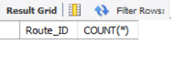
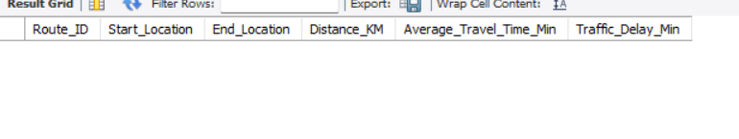
Task 3: Route Optimization Insights
Routes table was validated for duplicates, nulls, and correct data types.
SELECT Route_ID, COUNT(*) FROM routes_table GROUP BY Route_ID HAVING COUNT(*) > 1;
SELECT *FROM routes_table WHERE Route_ID IS NULL OR Distance_KM IS NULL OR Average_Travel_Time_Min IS NULL OR Traffic_Delay_Min IS NULL;

Slide 10
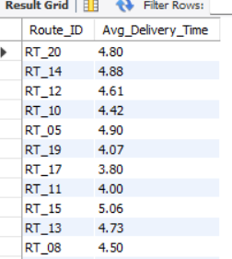
Average Delivery Time
SELECT Route_ID, ROUND(AVG(DATEDIFF(Actual_Delivery_Date, Order_Date)),2) AS Avg_Delivery_Time FROM orders_table GROUP BY Route_ID;

Slide 11
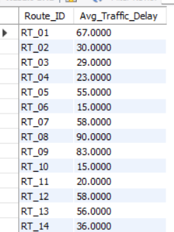
Average Traffic Delay
SELECT Route_ID,AVG(Traffic_Delay_Min) AS Avg_Traffic_Delay FROM routes_table GROUP BY route_id;

Slide 12
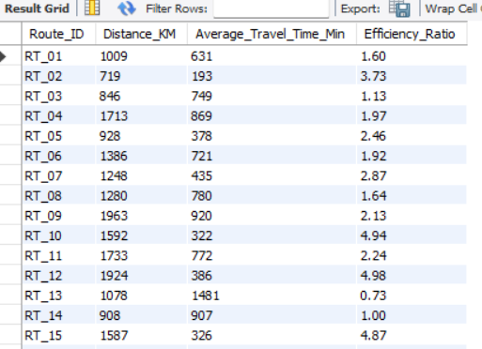
Efficiency Ratio
SELECT r.Route_ID,r.Distance_KM,r.Average_Travel_Time_Min,ROUND(r.Distance_KM / r.Average_Travel_Time_Min, 2) AS Efficiency_RatioFROM routes_table r;

Slide 13
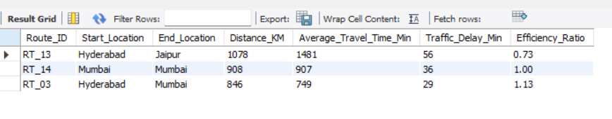
Worst 3 Routes (Efficiency)
SELECT Route_ID,Start_Location,End_Location,Distance_KM,Average_Travel_Time_Min,Traffic_Delay_Min,ROUND(Distance_KM / Average_Travel_Time_Min, 2) AS Efficiency_Ratio FROM routes_table ORDER BY Efficiency_Ratio ASC LIMIT 3;
Lower ratio = inefficient routes

Slide 14
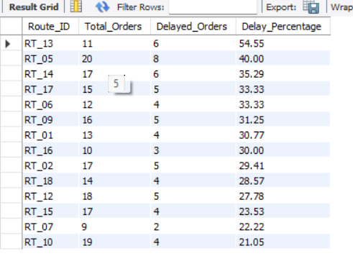
Routes with >20% Delayed Shipments
SELECT Route_ID, COUNT(*) AS Total_Orders, SUM(CASE WHEN Actual_Delivery_Date > Expected_Delivery_Date THEN 1 ELSE 0 END) AS Delayed_Orders, ROUND(SUM(CASE WHEN Actual_Delivery_Date > Expected_Delivery_Date THEN 1 ELSE 0 END) * 100.0 / COUNT(*), 2) AS Delay_Percentage FROM orders_table GROUP BY Route_ID HAVING SUM(CASE WHEN Actual_Delivery_Date > Expected_Delivery_Date THEN 1 ELSE 0 END) * 100.0 / COUNT(*) > 20 ORDER BY Delay_Percentage DESC;
High-Risk Routes (Immediate Attention)
-These routes have very high delay %:
RT_13 → 54.55% (worst)
RT_05 → 40.00%
RT_14 → 35.29%
More than 1 out of 3 deliveries are getting delayed.
-RT_13 appears everywhere (Worst delay + Worst %).

Slide 15
FINAL RECOMMENDATIONS
Fix High-Risk Routes First:
Focus on:
RT_13
RT_05
RT_14
Review route planning
Check traffic congestion patterns
Reassign delivery agents if needed
Investigate Root Cause
Traffic issues
~Long distance vs poor travel time
~Inefficient route mapping
Improve Scheduling
Use Best Routes as Benchmark

Slide 16
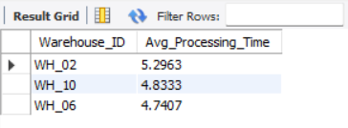
TASK:4~Warehouse Performance Analysis
Top 3 Warehouses with Highest Processing Time
Warehouse WH_02 has the highest average processing time i.e 5.29 days, indicating operational inefficiency and potential delays in order fulfillment.
SELECT Warehouse_ID,AVG(DATEDIFF(Actual_Delivery_Date, Order_Date)) AS Avg_Processing_Time FROM orders_table GROUP BY Warehouse_ID ORDER BY Avg_Processing_Time DESC LIMIT 3;

Slide 17
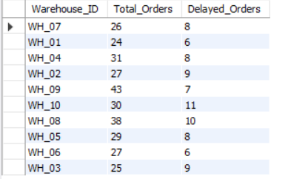
Total vs Delayed Shipments per Warehouse
SELECT Warehouse_ID,COUNT(*) AS Total_Orders,SUM(CASE WHEN Actual_Delivery_Date > Expected_Delivery_Date THEN 1 ELSE 0 END) AS Delayed_Orders FROM orders_table GROUP BY Warehouse_ID;
Worst Performing Warehouses
WH_10 → 11 delayed orders (highest)
WH_08 → 10 delayed orders
WH_02 & WH_03 → 9 delayed orders
These warehouses are major contributors to delivery delays and require operational improvements
Best Performing Warehouse
WH_09 → 43 total orders but only 7 delayed

Slide 18
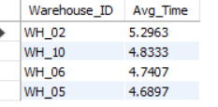
Bottleneck warehouses (bottleneck warehouses )
WITH avg_time AS ( SELECT AVG(DATEDIFF(Actual_Delivery_Date, Order_Date)) AS Global_Avg FROM orders_table)SELECT o.Warehouse_ID,AVG(DATEDIFF(o.Actual_Delivery_Date, o.Order_Date)) AS Avg_TimeFROM orders_table oCROSS JOIN avg_time aGROUP BY o.Warehouse_ID HAVING AVG(DATEDIFF(o.Actual_Delivery_Date, o.Order_Date)) > (SELECT Global_Avg FROM avg_time) ORDER BY Avg_Time DESC;
WH_02 is the biggest bottleneck (highest delay)
Followed by WH_10, WH_06, WH_05
These warehouses need:
Process optimization
Resource allocation
Capacity improvement

Slide 19
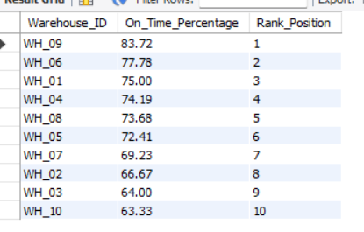
Rank warehouses based on on-time delivery percentage
SELECT Warehouse_ID,ROUND(SUM(CASE WHEN Actual_Delivery_Date <= Expected_Delivery_Date THEN 1 ELSE 0 END) * 100.0 / COUNT(*), 2) AS On_Time_Percentage,RANK() OVER (ORDER BY SUM(CASE WHEN Actual_Delivery_Date <= Expected_Delivery_Date THEN 1 ELSE 0 END) * 1.0 / COUNT(*) DESC) AS Rank_Position FROM orders_table GROUP BY Warehouse_ID;
WH_09 =Best performing warehouse
WH_10 =Worst performer

Slide 20
KEY INSIGHTS ( Warehouse Performance)
WH_09 achieved the highest on-time delivery rate (83.72%)
WH_10 showed the lowest performance (63.33%)
Bottleneck warehouses like WH_02 and WH_10 require optimization
Some warehouses (e.g., WH_06) handle high processing time but still maintain good delivery performance
Operational improvements are required in low-performing warehouses

Slide 21
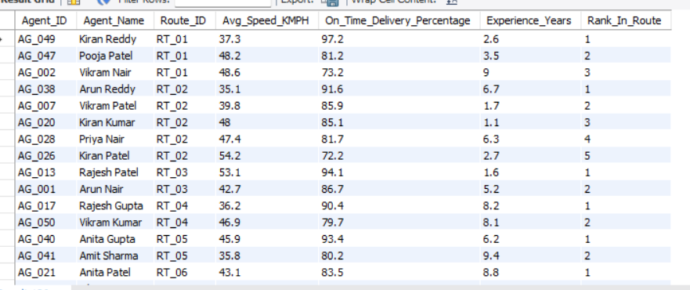
Task 5: Delivery Agent Performance
Rank agents (per route) by on-time delivery percentage
SELECT Agent_ID,Agent_Name,Route_ID,Avg_Speed_KMPH,On_Time_Delivery_Percentage,Experience_Years,RANK() OVER (PARTITION BY Route_ID ORDER BY On_Time_Delivery_Percentage DESC) AS Rank_In_Route FROM deliveryagents_table ORDER BY Route_ID, Rank_In_Route;

Slide 22
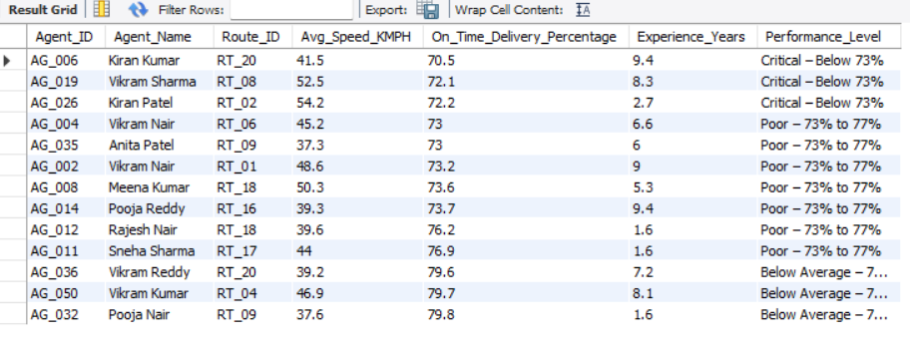
Agents with on-time % < 80%
SELECT Agent_ID, Agent_Name,Route_ID, Avg_Speed_KMPH, On_Time_Delivery_Percentage,Experience_Years, CASE WHEN On_Time_Delivery_Percentage < 73 THEN 'Critical – Below 73%' WHEN On_Time_Delivery_Percentage < 77 THEN 'Poor – 73% to 77%' ELSE 'Below Average – 77% to 80%' END AS Performance_Level FROM deliveryagents_table WHERE On_Time_Delivery_Percentage < 80ORDER BY On_Time_Delivery_Percentage ASC;

Slide 23

avg speed of Top 5 vs Bottom 5 agents using subqueries
SELECT 'Top 5 Agents (Best On-Time %)' AS Agent_Group, ROUND(AVG(Avg_Speed_KMPH), 2) AS Avg_Speed_KMPH FROM (SELECT Avg_Speed_KMPH FROM deliveryagents_table ORDER BY On_Time_Delivery_Percentage DESC LIMIT 5) top5 UNION ALL SELECT 'Bottom 5 Agents (Worst On-Time %)' AS Agent_Group, ROUND(AVG(Avg_Speed_KMPH), 2) AS Avg_Speed_KMPH FROM (SELECT Avg_Speed_KMPH FROM deliveryagents_table ORDER BY On_Time_Delivery_Percentage ASC LIMIT 5) bottom5;
KEY INSIGHTS- Bottom agents drive FASTER (46.14 kmph) than top agents (44.08 kmph). Speed is NOT the problem — they are rushing deliveries and skipping proper handover steps. The solution is accuracy training, not speed improvement

Slide 24
Suggestions for Low Performers
1. Agents who are Critical (below 73%) with high experience (5+ years) → AG_006 (9.4 yrs), AG_019 (8.3 yrs), AG_004 (6.6 yrs), AG_035 (6.0 yrs), AG_014 (9.4 yrs) Suggestion: These agents are experienced but underperforming — reassign them to shorter or less congested routes (like RT_10, RT_11 which have 0% delay) instead of training.
2. Agents who are Critical with low experience (below 3 years) → AG_026 (2.7 yrs) Suggestion: Enroll in a structured delivery training program and pair with a top-performing agent on the same route before working independently.
3. Agents driving too fast (above 48 kmph) but delivering poorly → AG_019 (52.5 kmph), AG_026 (54.2 kmph), AG_008 (50.3 kmph), AG_002 (48.6 kmph) Suggestion: Speed is not the problem — accuracy is. Enforce a maximum speed policy and focus training on proper handover, customer confirmation, and proof-of-delivery steps.
4.General workload balancing
→ RT_18 has 2 low performers (AG_008 and AG_012) on the same route
Suggestion: Redistribute orders from overloaded routes to better-performing routes. Use the on-time % data monthly to rotate agents across routes and prevent burnout.

Slide 25
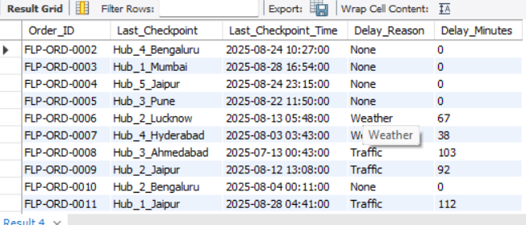
Task 6: Shipment Tracking Analytics
For each order, the last checkpoint and time.
WITH RankedCheckpoints AS (SELECT Order_ID,Checkpoint,Checkpoint_Time,Delay_Reason,Delay_Minutes,ROW_NUMBER() OVER (PARTITION BY Order_ID ORDER BY Checkpoint_Time DESC ) AS rn FROM shipmenttracking_table)SELECT Order_ID, Checkpoint AS Last_Checkpoint, Checkpoint_Time AS Last_Checkpoint_Time,Delay_Reason,Delay_Minutes FROM RankedCheckpoints WHERE rn = 1 ORDER BY Order_ID;

Slide 26
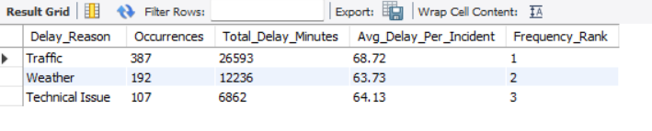
The most common delay reasons
SELECT Delay_Reason, COUNT(*) AS Occurrences, SUM(Delay_Minutes) AS Total_Delay_Minutes, ROUND(AVG(Delay_Minutes), 2) AS Avg_Delay_Per_Incident,RANK() OVER (ORDER BY COUNT(*) DESC) AS Frequency_Rank FROM shipmenttracking_table WHERE Delay_Reason IS NOT NULL AND UPPER(TRIM(Delay_Reason)) != 'NONE' GROUP BY Delay_Reason ORDER BY Occurrences DESC;
KEY INSIGHTS:- Traffic is the #1 cause of delays — 387 occurrences adding up to 26,593 total minutes of delay. That's 443 hours lost just due to traffic. Real-time route rerouting during peak hours would significantly reduce this.

Slide 27
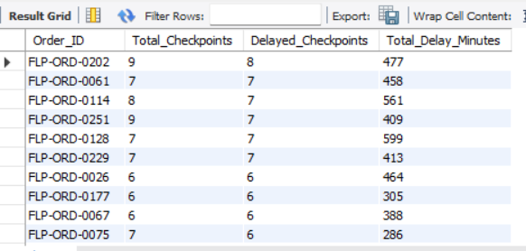
orders with >2 delayed checkpoints
SELECT Order_ID,COUNT(*) AS Total_Checkpoints, SUM(CASE WHEN Delay_Minutes > 0 THEN 1 ELSE 0 END) AS Delayed_Checkpoints,SUM(Delay_Minutes) AS Total_Delay_Minutes FROM shipmenttracking_table GROUP BY Order_ID HAVING SUM(CASE WHEN Delay_Minutes > 0 THEN 1 ELSE 0 END) > 2 ORDER BY Delayed_Checkpoints DESC;

Slide 28
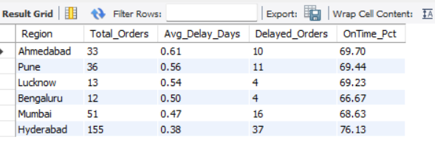
Task 7: Advanced KPI Reporting
Average Delivery Delay per Region (Start_Location)
SELECT r.Start_Location AS Region,COUNT(o.Order_ID) AS Total_Orders,ROUND(AVG(DATEDIFF(o.Actual_Delivery_Date, o.Expected_Delivery_Date)),2) AS Avg_Delay_Days,SUM(CASE WHEN DATEDIFF(o.Actual_Delivery_Date,o.Expected_Delivery_Date) > 0 THEN 1 ELSE 0 END) AS Delayed_Orders,ROUND(100.0 * SUM(CASE WHEN DATEDIFF(o.Actual_Delivery_Date,o.Expected_Delivery_Date) <= 0 THEN 1 ELSE 0 END) / COUNT(o.Order_ID), 2) AS OnTime_Pct FROM orders_table o JOIN routes_table r ON o.Route_ID = r.Route_ID GROUP BY r.Start_Location ORDER BY Avg_Delay_Days DESC;

Slide 29
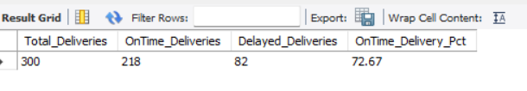
On-Time Delivery %
SELECT COUNT(*) AS Total_Deliveries,SUM(CASE WHEN DATEDIFF(Actual_Delivery_Date,Expected_Delivery_Date) <= 0 THEN 1 ELSE 0 END) AS OnTime_Deliveries,SUM(CASE WHEN DATEDIFF(Actual_Delivery_Date,Expected_Delivery_Date) > 0 THEN 1 ELSE 0 END) AS Delayed_Deliveries,ROUND(100.0 * SUM(CASE WHEN DATEDIFF(Actual_Delivery_Date,Expected_Delivery_Date) <= 0THEN 1 ELSE 0 END) / COUNT(*), 2) AS OnTime_Delivery_Pct FROM orders_table;

Slide 30
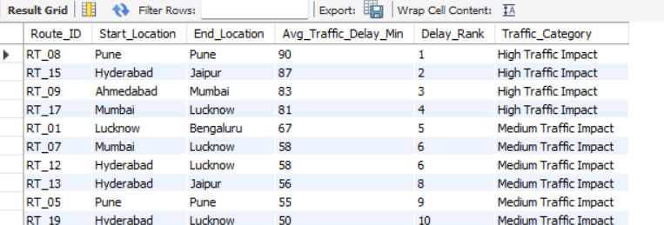
Average Traffic Delay per Route
SELECT Route_ID, Start_Location, End_Location, Traffic_Delay_Min AS Avg_Traffic_Delay_Min, RANK() OVER (ORDER BY Traffic_Delay_Min DESC) AS Delay_Rank, CASE WHEN Traffic_Delay_Min >= 80 THEN 'High Traffic Impact' WHEN Traffic_Delay_Min >= 50 THEN 'Medium Traffic Impact' ELSE 'Low Traffic Impact' END AS Traffic_Category FROM routes_table ORDER BY Traffic_Delay_Min DESC;

